Slide 1

Iterating through Iterations
Born-Digital Transfers at Archives New Zealand

Slide 2
Iterative Approach
Develop
Improve
Learn
Implement
Consult

Slide 3

Current Born-Digital Ingest Process
Validate
Integrity
of Extract
Initial Record
Analysis
Test Ingest
Into
Repository
Metadata
Import into
Test
Catalogue
Fix Technical
Issues with
Ingest
Pre-
Conditioning
Create
Provenance
Notes
Create
Distilled Set
& Ingest CSV
Test Ingest
With
Metadata
Rework Until It’s Right
User Testing
Share and
Discuss Test
Results
Acceptance
Of
Test Ingest
Configure
Production
Repository
Pre-Ingest
Reports
Finalised
Metadata
Import into
Production
Catalogue
Re-Validate
Integrity
Ingest into
Production
Repository
Business
Check Results
Delete Files
From Network
Storage

Slide 4
Interim Born-Digital Transfer Stages
0. Transfer
Initiation
1. Extraction
Feasibility
Check
2. Test
Transfer
3. Actual
Transfer

Slide 5
Current Born-Digital Transfer Feasibility Check Process
Learn about
Agency’s
Recordkeeping
System
Finalise Test
Extract
Requirements
Agency
Delivers
Extract
Validate
Integrity
of Extract
Test Ingest
Into
Repository
Consolidate
Analysis
Into Report
Identify
Options for
Moving
Forward
Initial Record
Analysis

Slide 6
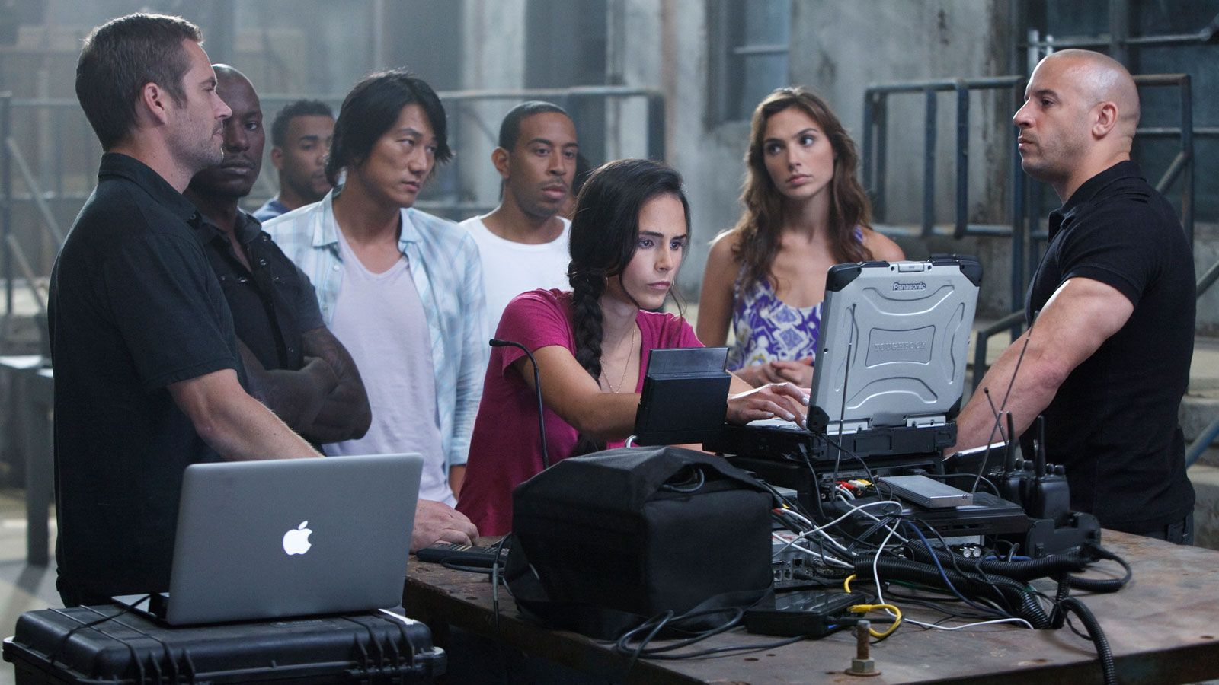
Assemble Your Team
And make sure they’re supported!

Slide 7
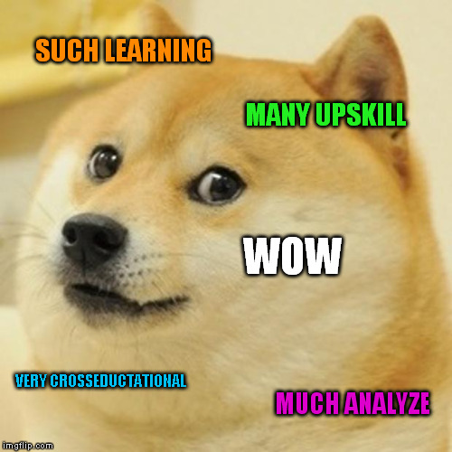
Identify Learning Opportunities

Slide 8
Name Your Benchmarks
Quantifiable & Measurable

Slide 9
PRESERVATION
RELATIONSHIPS
BITS & BYTES
CONTENT

Slide 10
Knowing the Gaps
Current Catalogue Cannot Accurately Describe Born-Digital Objects and their Relationships
Difficulties with Content Sentencing

Slide 11
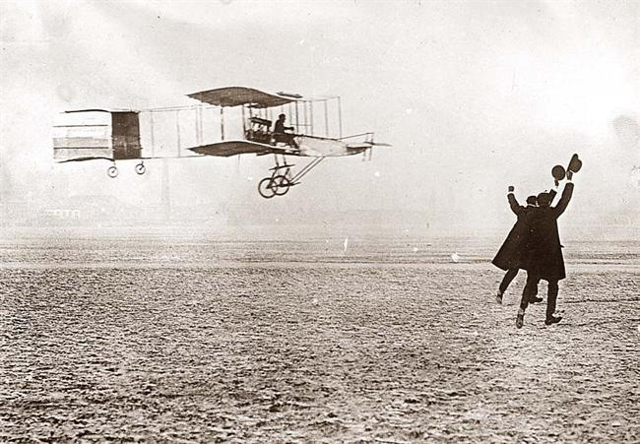
SCIENCE!

Slide 12
Thank You!
andrea.byrne@dia.govt.nz
@andreakbyrne

